Slide 1

End – to – End Sales Prediction Solutions For Retail Sales By Pavan Kumar

Slide 2
INDEX 1. Objective 2. Importing Dataset 3. Handling Missing Values.. 4. Finding Patterns. 5. Training Dataset steps. 6. Prediction .

Slide 3
Objective We are tasked with a sales forecasting project for Rossman Pharmaceuticals. The finance team aims to predict sales across all stores in various cities, six weeks in advance. Historically, sales forecasting relied on managerial experience and judgment. Your objective is to deliver an end-to-end predictive solution to help the finance team plan effectively.

Slide 4
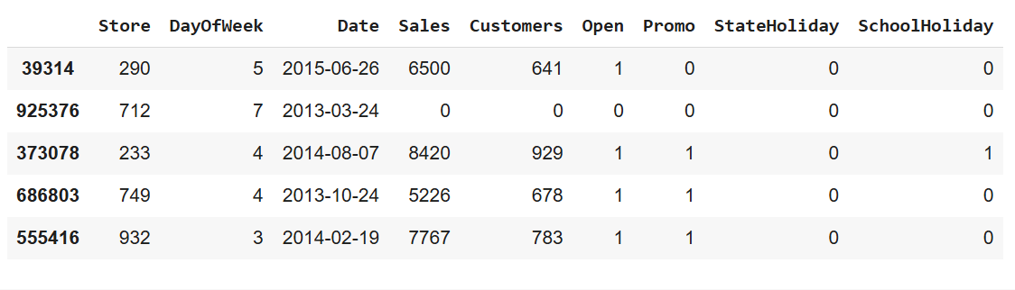
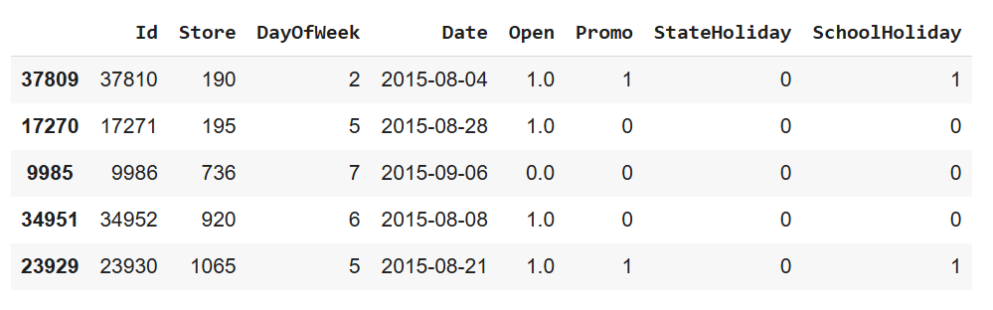
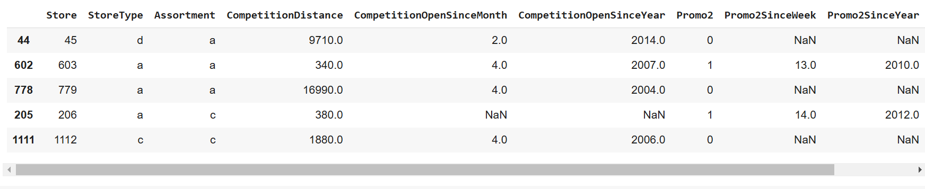
Importing Data Set: 1) Importing the Data Set: a) In This we have Three Dataset Training, Test , Store Dataset as shown as above. import pandas as pd d1=pd.read_csv(r"E:\DIGI chrome\Data sets\Train Data.csv")

Slide 5
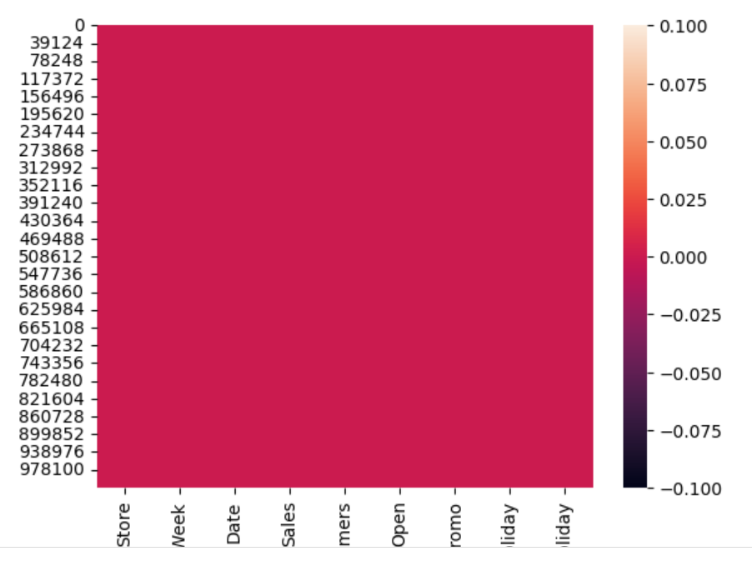
Handling Missing Values 1) Handling Missing Values : We have checked any missing values are present but there is no missing values. Import seaborn as sns sns.heatmap(d1.isnull()) 2) Duplicated data: And also we have checked any duplicates are there but there are no duplicates. d1.duplicated().any()

Slide 6
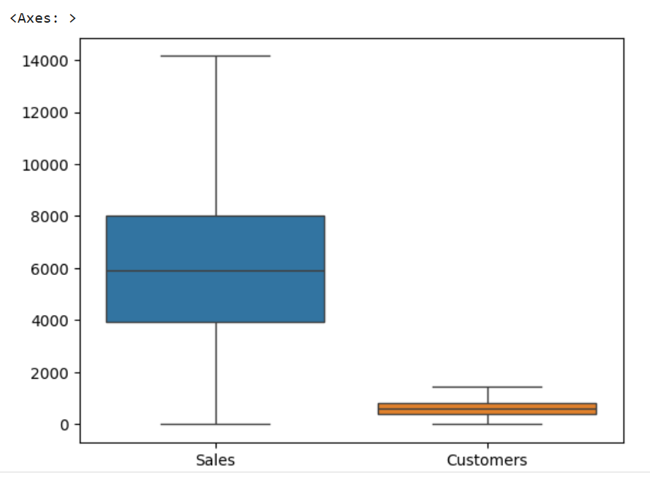
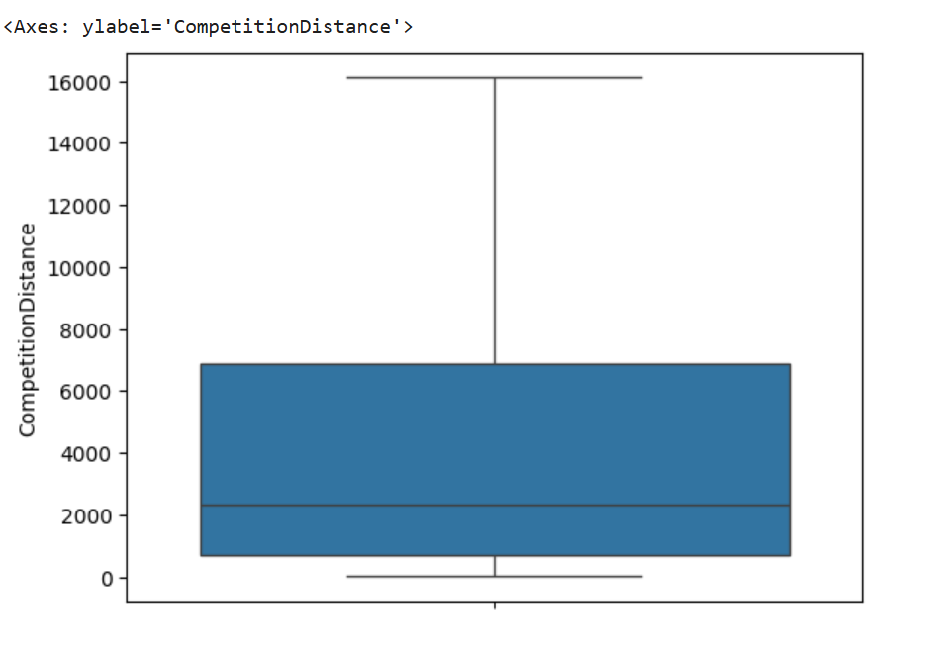
Handling Outliers 1) Handling Outliers: a) For handling the Outliers I have used the IQR Method , For that first we have to find the upper bond and lower bond and then we have update the values or delete the rows which has the value greater than upper bond and lower bond . For Two Datasets train and store dataset we have found the outliers and then we have done capping. upper_limit = Q3 + (1.5 * IQR) lower_limit = Q1 - (1.5 * IQR) d1.loc[d1[x] > upper_limit, x] = upper_limit d1.loc[d1[x] < lower_limit, x] = lower_limit

Slide 7
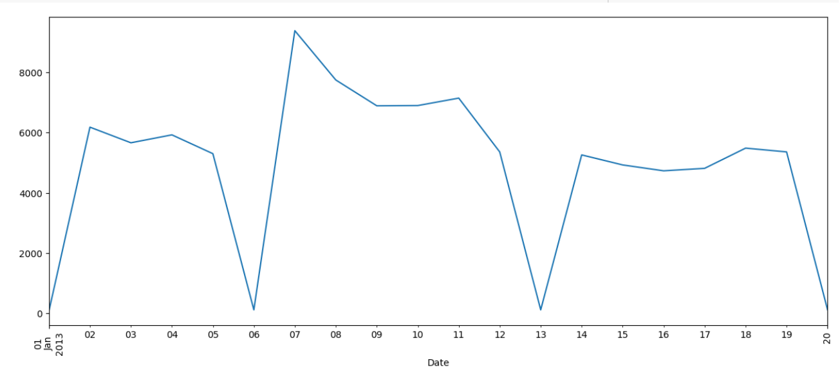
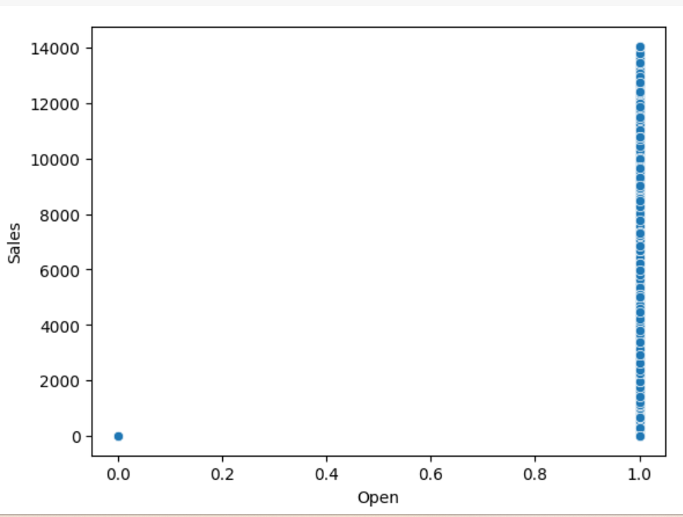
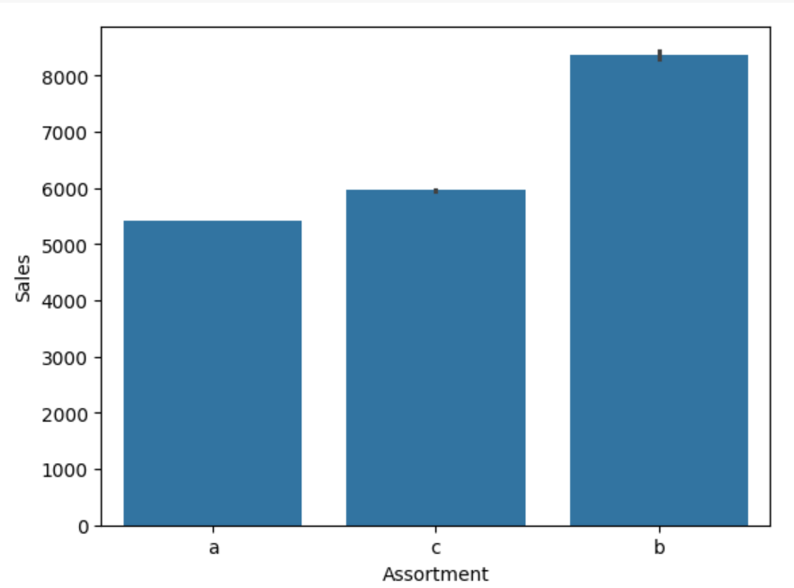
Analysis: From The 1st Fig we can say that January 6th 2013 has the highest sales in the Month , When the Promo code is applied the Sales are Very High ,If you See the Assortment type ‘b’ it has more Sales than the another assortments.

Slide 8
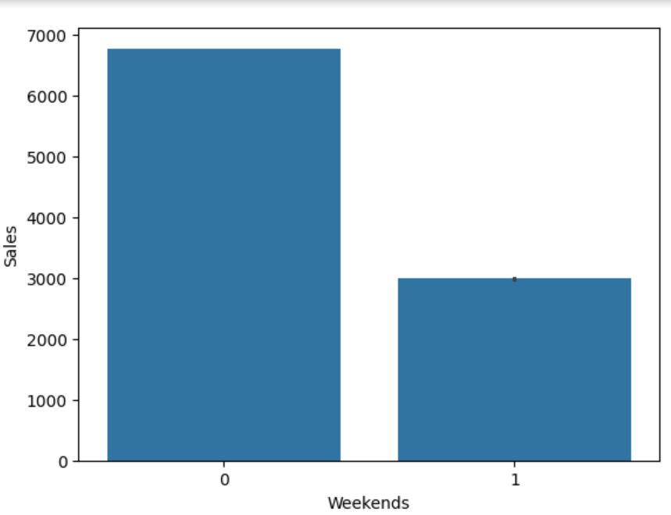
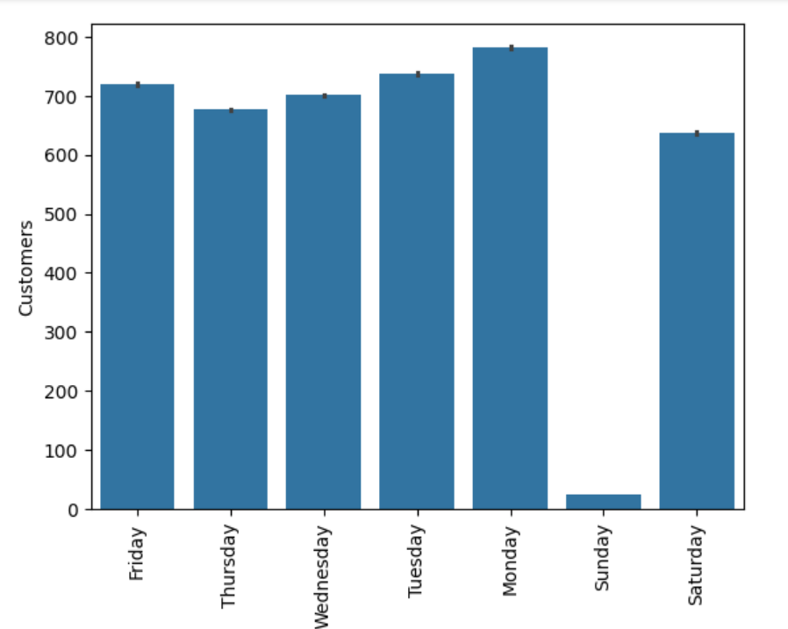
Analysis: We Have compared how the sales on Weekdays and weekends: 1) On Weekends the Sale is High Because only on weekends the Sale has happened almost half of weekdays . 2) On weekdays The sale on Monday is high.

Slide 9
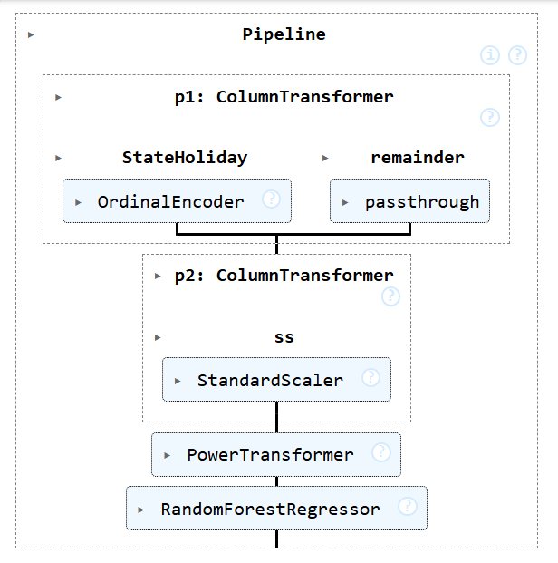
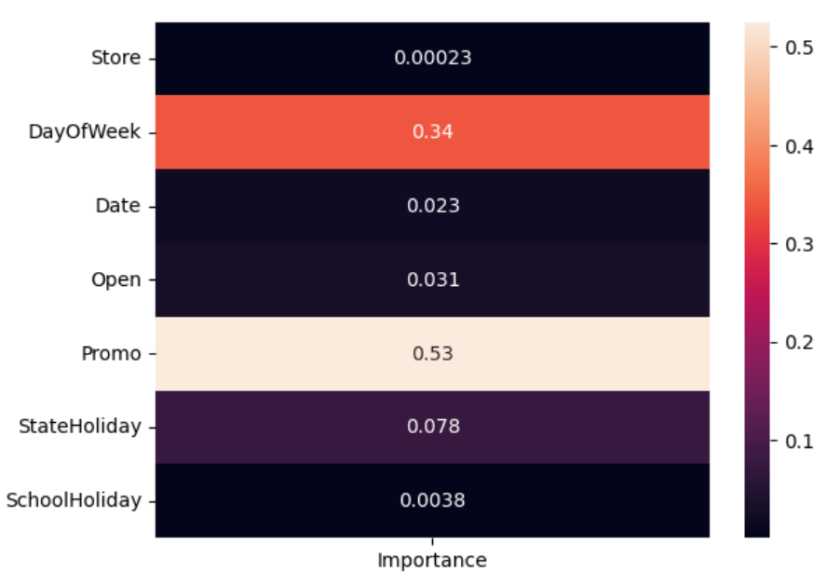
Analysis: 1) For training and Predicting the model we have followed the above steps that are mentioned in first image like , Encoding categorial variable, standard scaler, Power transform, Random Forest Algorithm. 2) The Second Says About the feature importance from ths diagram we can say that Promo code has more important to increase the Sales.

Slide 10
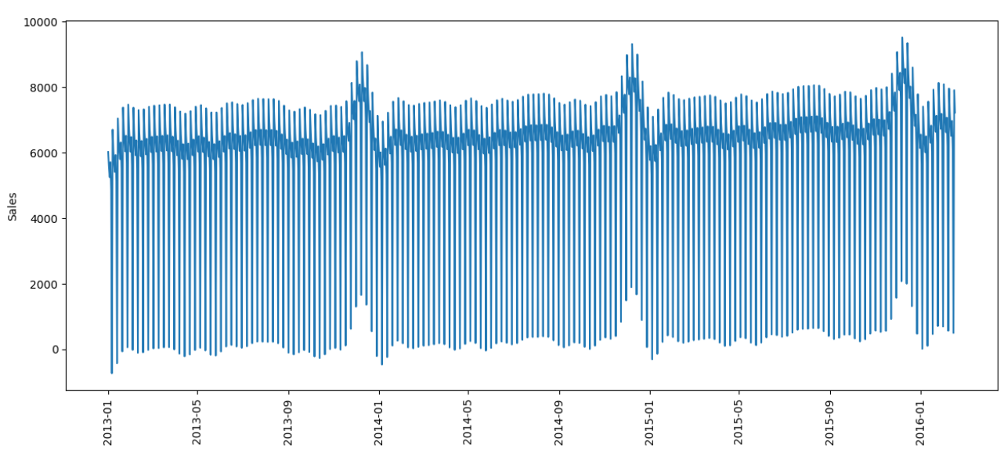
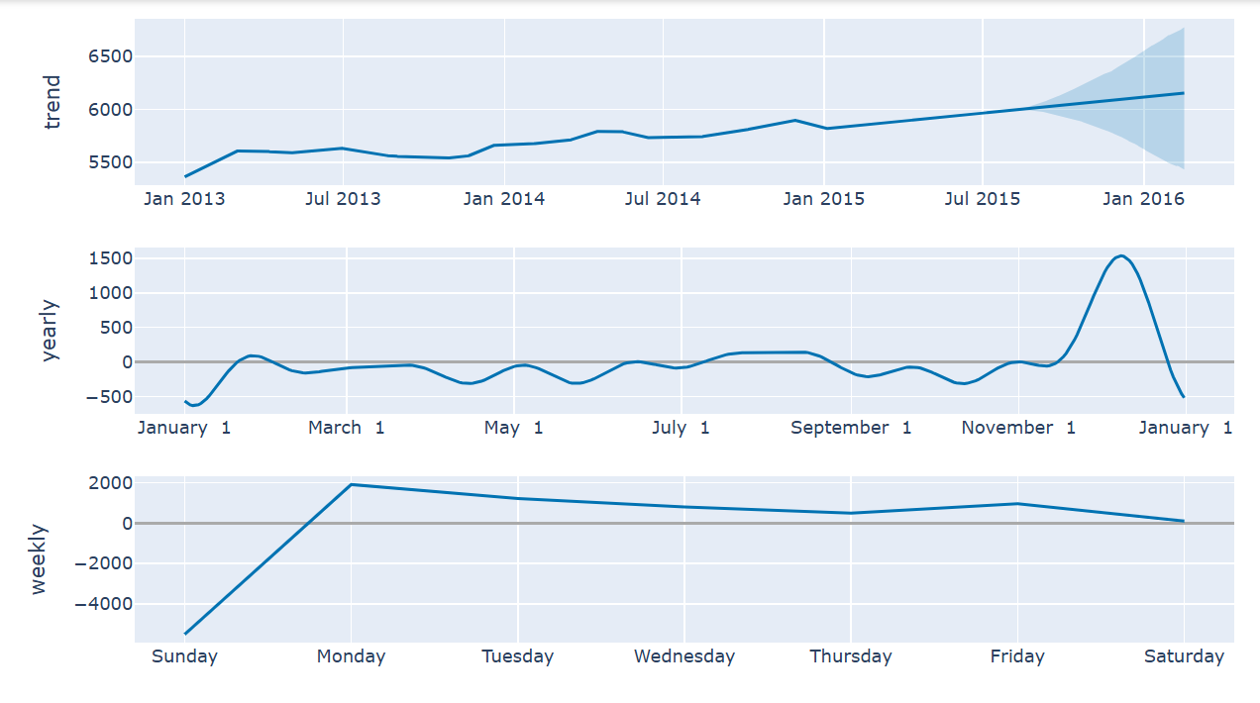
Analysis: The first diagram tells the sales for next Six months, In the second diagram the prediction is distributed into yearly weekly and also how the trend will be.

Slide 11
Thank You!

